Slide 1
Woodland Public Schools
Facilities and Safety Report
October 2016

Slide 2
FACILITIES REPORT
WSD Emergency Response Plan – A new District Emergency Response Plan is in final draft and will be delivered to the Superintendent for review in November. This plan is the umbrella for school level plans throughout the District. The procedure is arranged into two distinct sections. The first section involves district level guidance for emergency planning and the second section contains procedures for each of the schools. It creates a uniform response for all school emergencies based on the results of a probability model that have been completed at four of the schools that identifies and prioritizes risks specific to each school.
Card Key Access System – Final review of card key access system proposals for WPS, WIS, WMS are in progress. Once installed, all external doors at all of the schools will be rekeyed to alleviate the current “everyone has a key” to the Woodland School doors phenomenon. The system provides card key access at strategic locations throughout each school for normal access and for facility use patrons. Each access point will be controlled through electric door strikes and the associated hardware. A duel side proximity card printer will be used to place the employees picture on the card and serve as the Employees badge.
Job Safety Analysis (JSA’s) – Occupational health requires all employees be orientated to their work areas to identify potential hazards associated with their jobs and to ensure they have an detailed understanding of safety equipment and egress routes from their normal place of work. The JSA’s were delivered to the schools for deployment to their employees. WMS did a great job completing the JSA’s for their team creating both a fun and exciting challenge to find pull stations, AEDs and Fire extinguishers.

Slide 3
FACILITIES REPORT
LED conversion WMS- North coast electrical conducted a detailed survey of the WMS complex to assist in developing the ROI for converting to schools to LED. As stated in a previous board report, the benefits of shifting to LED include, better lighting color, energy savings (lamps and transformation) and maintenance savings. I expect to have the proposal before December 1^{st.}
Lead Testing – Initial lead testing at WPS and WIS resulted in all fixtures falling well below the threshold of 20 parts per billion. This meets the requirement of WAC 246-366A-130 (Water quality monitoring—Lead). The WAC states that school officials shall conduct initial monitoring by sampling fifty percent of the plumbing fixtures regularly used for drinking or cooking in elementary schools or used by preschool children in K-12 schools within one year after the effective date of the WAC (July 2017) We will be responsible to sample the remaining fifty percent of the fixtures within two years of the effective date of the WAC (by July 2019).

Slide 4
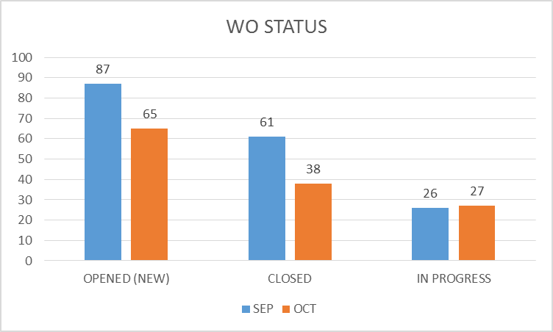
FACILITY CHARTS – POWER COST AND WORK ORDER STATUS

Slide 5
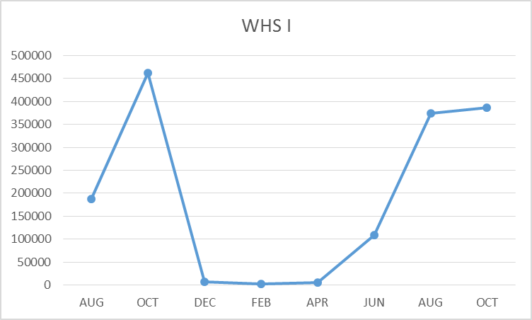
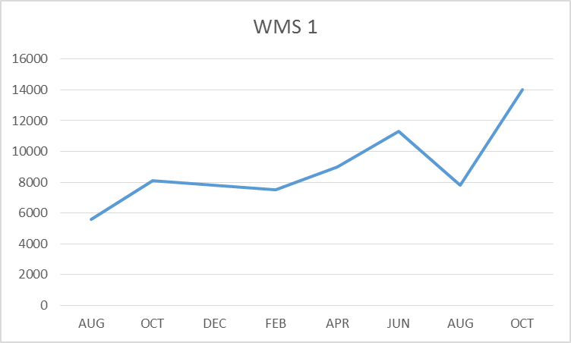
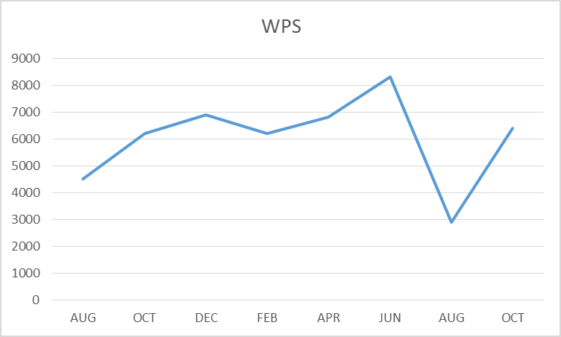
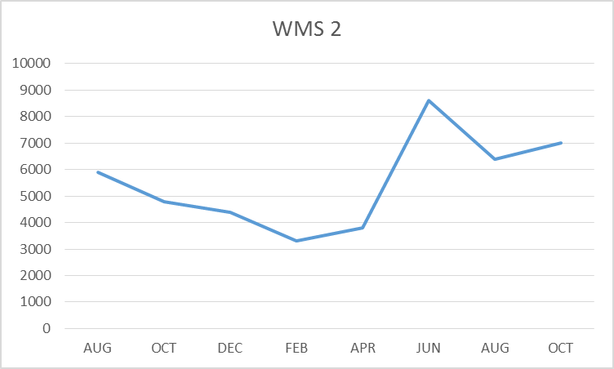
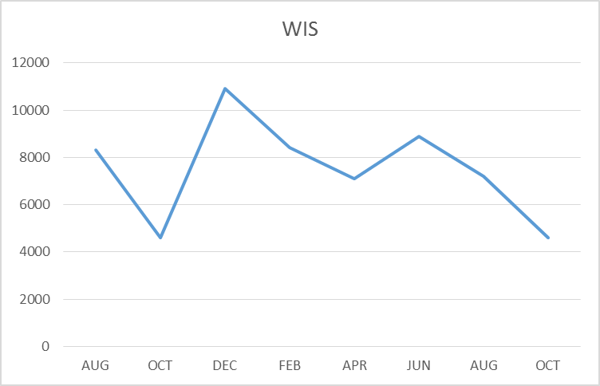
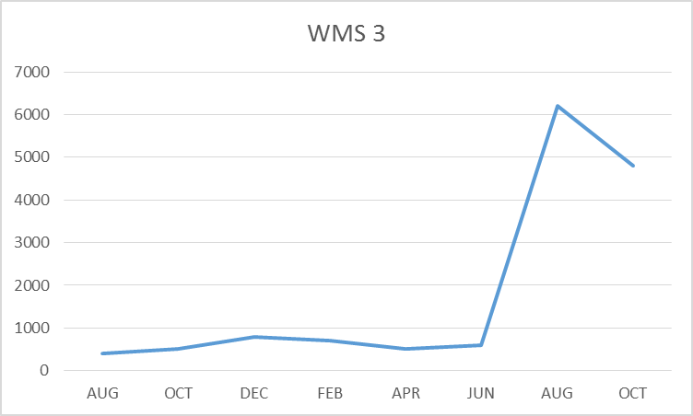
FACILITY CHARTS – WATER USAGE, WHS, WIS, WMS, WPS

Slide 6
SAFETY
Accidents for the month
There were a total of 13 injuries in the month of October 7 students and 6 staff members.
Staff Accidents/Incidents (6)
WPS – Angry student kicked and hit employee multiple times
WPS – Angry student kicked IA multiple times
WPS – Employee fell while chasing runaway student
WPS – Angry student hit employee in the arm
WPS – Angry student hit and kicked employee
Team high – Wheel chair employee injured hand when transitioning through doorway
Student Accidents/injuries
WHS – Student suffered possible anxiety attack
Yale – Student slipped at recess and bumped head
WIS – Student running backwards hit head on pole
WHS – Student broke finger sprained wrist at JV football game
WHS – Student sprained ankle at football game
WHS – Student fell and injured shoulder playing volleyball game
WPS - Agitated student fell while jumping desk to desk

Slide 7
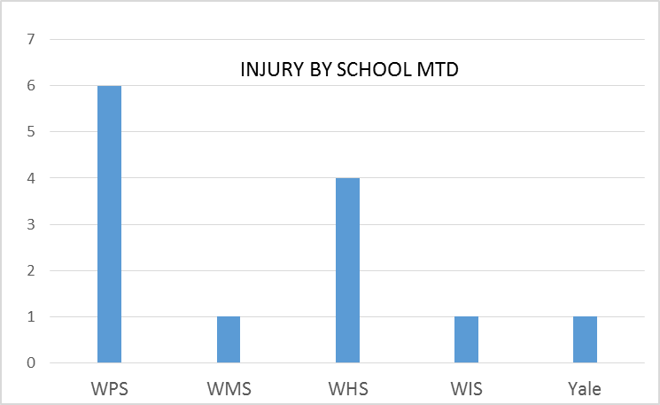
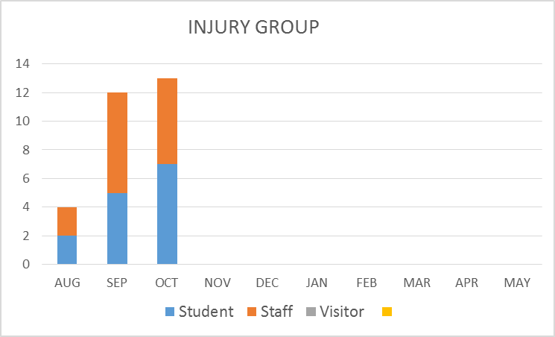
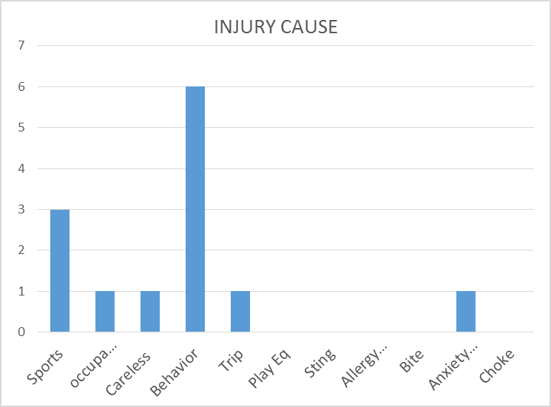
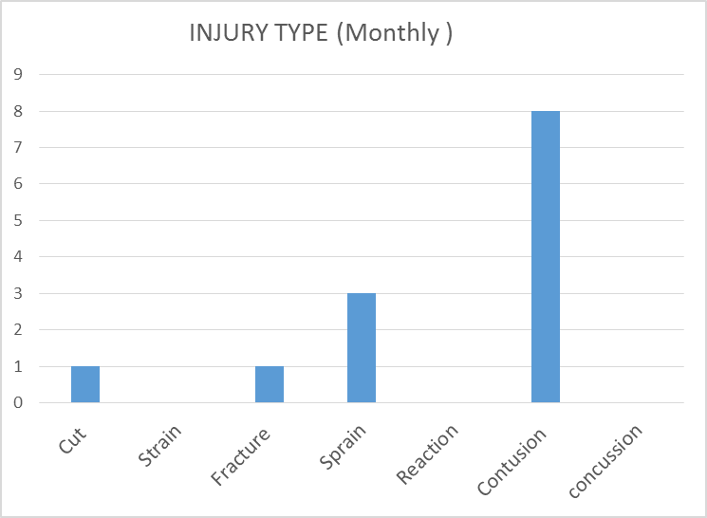
SAFETY CHARTS

